Slide 1
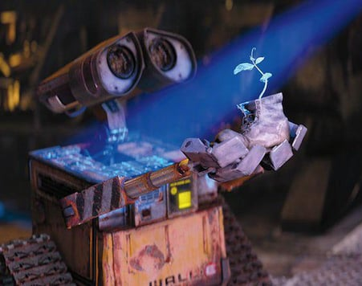
VEE – The Gesture-Responsive Waving Robot
Kashvi ,Nandini,Sohit,Khyati,Harsh
B.Tech CSE, 1st Year
Department of Computer Science & Engineering
GLA Greater Noida

Slide 2

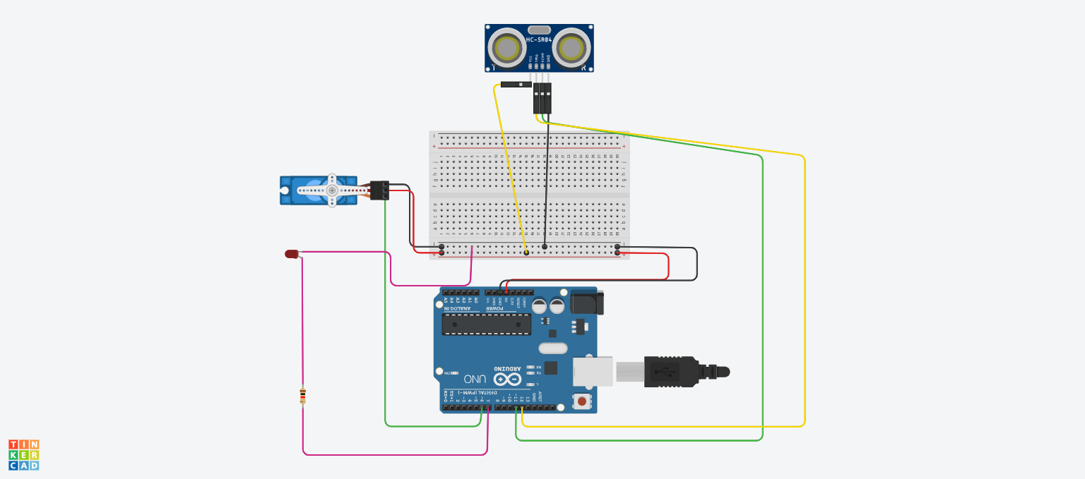
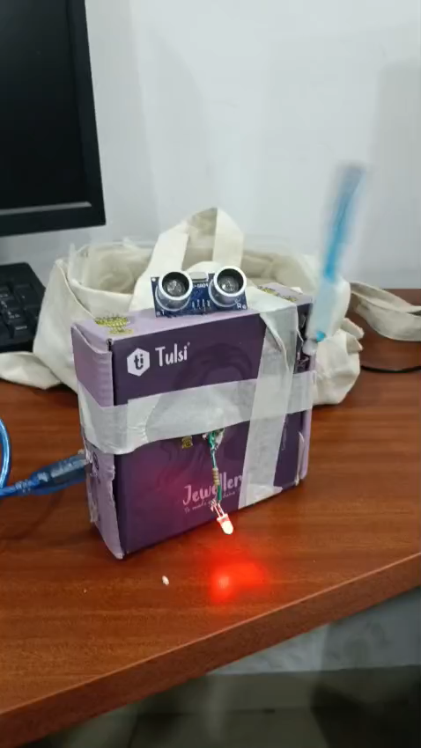
Aim / Objective
Detect human presence using distance measurement.
Respond with a waving gesture.
Learn how sensors, microcontrollers, and actuators work together.
Build a foundation for future robotics/AI projects.

Slide 3
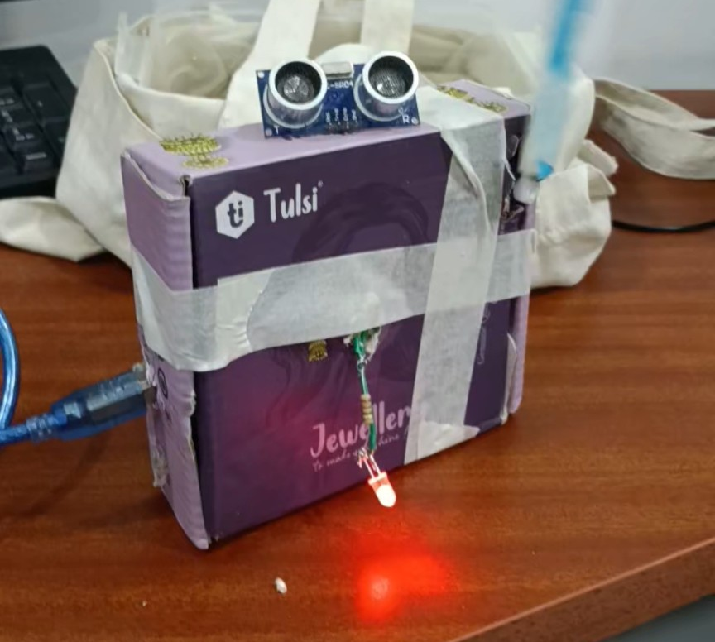
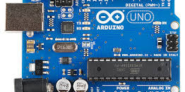
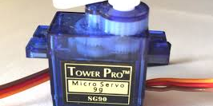
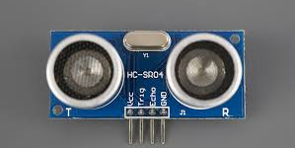
Use pictures of each component:
Components Used
Arduino UNO
HC-SR04 Ultrasonic Sensor
SG90 Micro Servo
Breadboard
Jumper Wires
LED (optional)

Slide 4
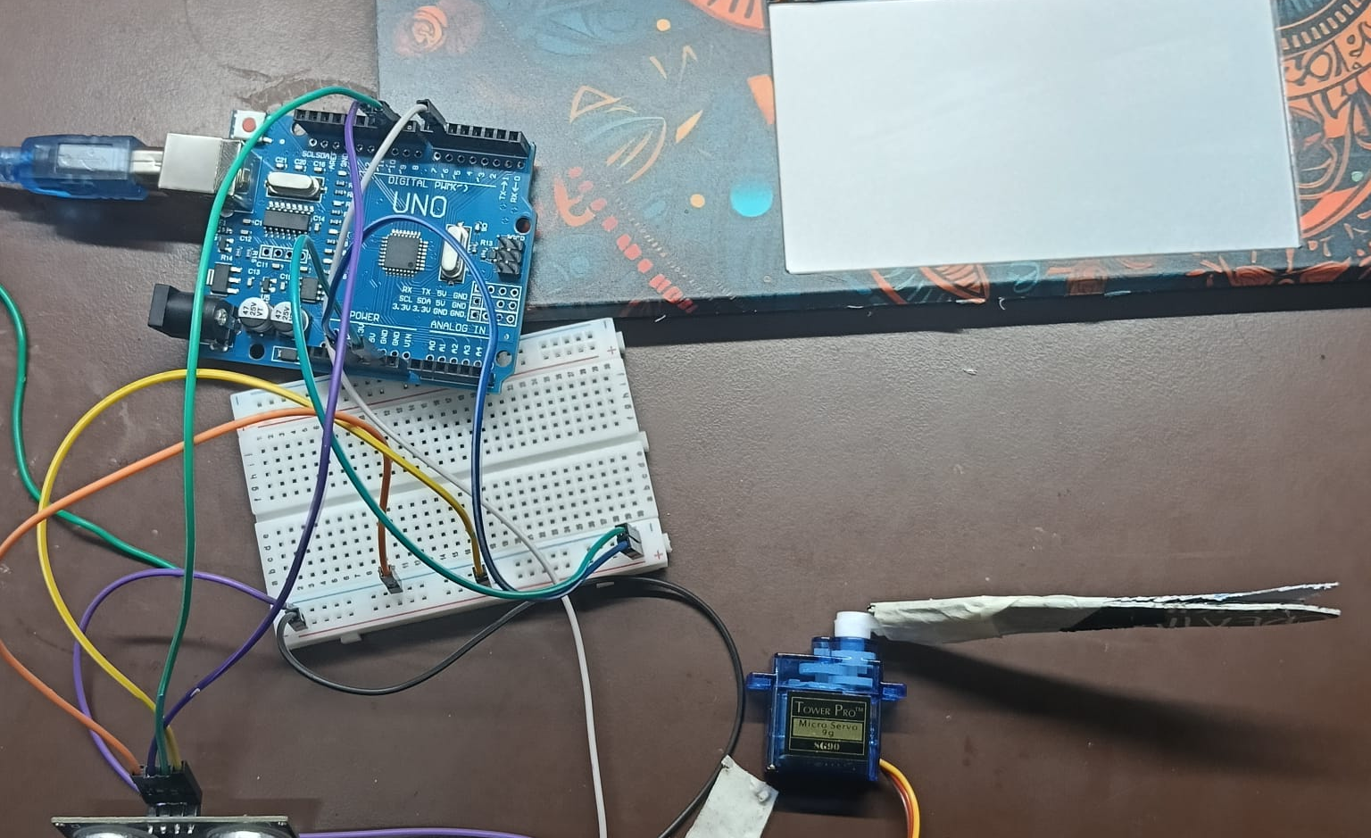
Circuit Diagram
Insert your TinkerCAD screenshot or your real breadboard picture.
Labels needed:
Trig → Digital Pin 9
Echo → Digital Pin 10
Servo Signal → Digital Pin 3 or 5
VCC → 5V
GND → GND

Slide 5
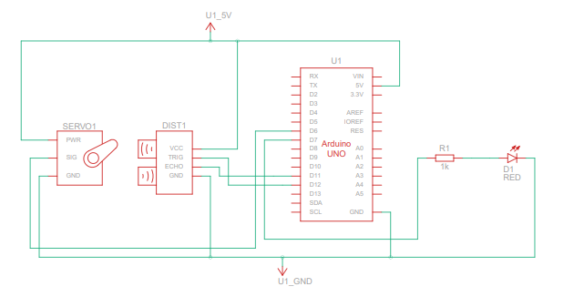
Circuit

Slide 6

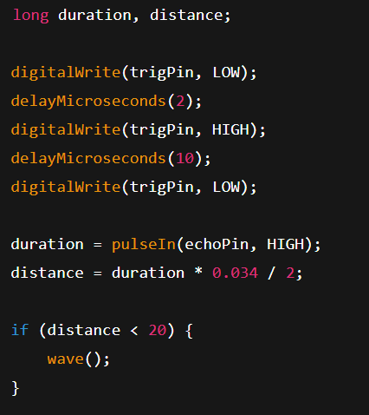
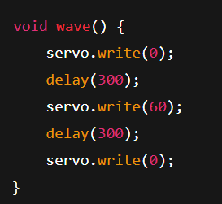
Code Snippets

Slide 7
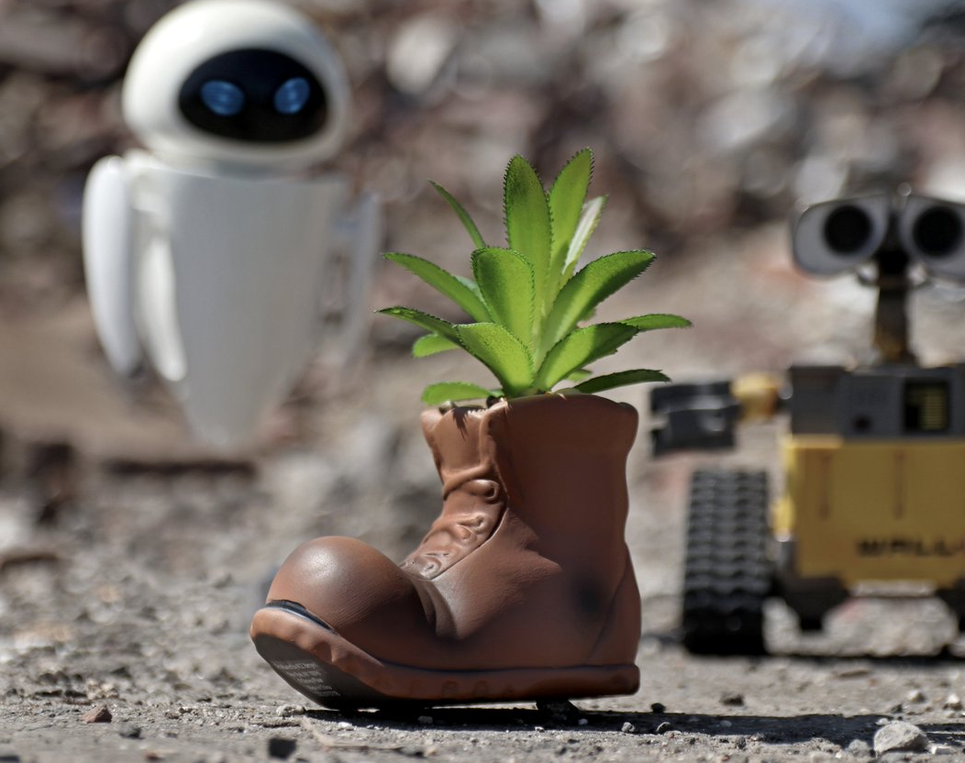
Future Improvements
Add voice ("Hello, VEE here!")
Add following the owner.
Add eyes/face display
Add multi-gesture features
Convert into a full WALL-E style Gardener Robot

Slide 8
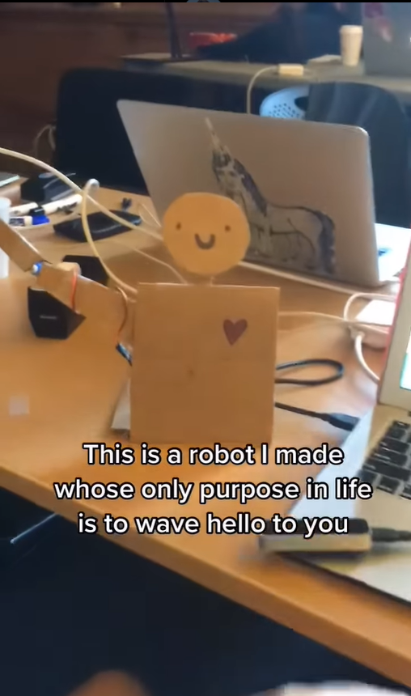
Reference
Reference is taken from the reel of the account
Roboticks
https://www.instagram.com/reel/DNaJnIKMDbS/?utm_source=ig_web_copy_link&igsh=MzRlODBiNWFlZA==

Slide 9

Conclusion
VEE successfully responds to human gestures.
Demonstrates basics of sensing + actuation.
Useful learning project for robotics and engineering.
Opens path to intelligent social robots.

